Slide 1
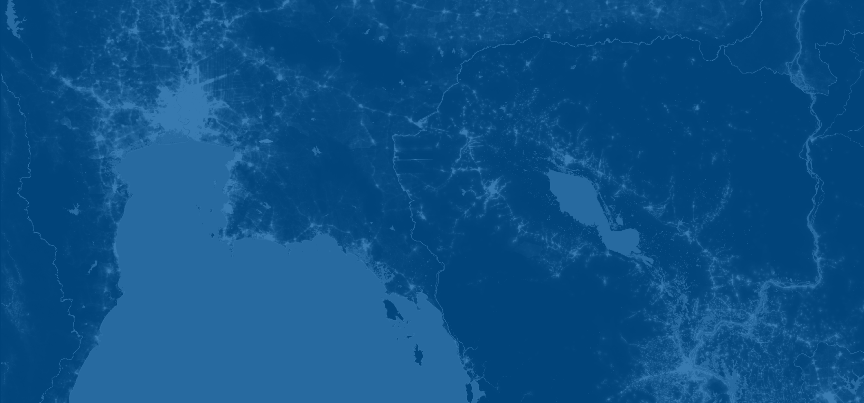



Introduction to spatial statistics
C. Edson Utazi
October 2026

Slide 2
Learning objectives
By the end of this session, you will be able to:
Explain the fundamental concept of spatial statistics.
Distinguish between the main types of spatial data and describe the relationships between them.
Describe how spatial data are measured, represented, and stored in different data formats.
Calculate and interpret distances between spatial locations using spatial coordinates.

Slide 3
What is spatial statistics?
Spatial statistics is an area of statistics that lies at the interface of statistics and geography
It refers to a body of methods for analysing data collected over space or over space and time
It originated from mining exploration around the 1960s (Georges Matheron; Danie G. Krige)
Other terms used for this field are: geospatial analysis, geostatistics, space-time modelling, etc

Slide 4
What is spatial statistics?
Unlike conventional cross-sectional data, observations in spatial datasets are often not independent.
Spatial dependence arises because observations that are geographically close tend to be more similar than those that are far apart (Tobler’s first law of geography).
In spatiotemporal data, observations may also be correlated across time, giving rise to both spatial and temporal dependence.

Slide 5
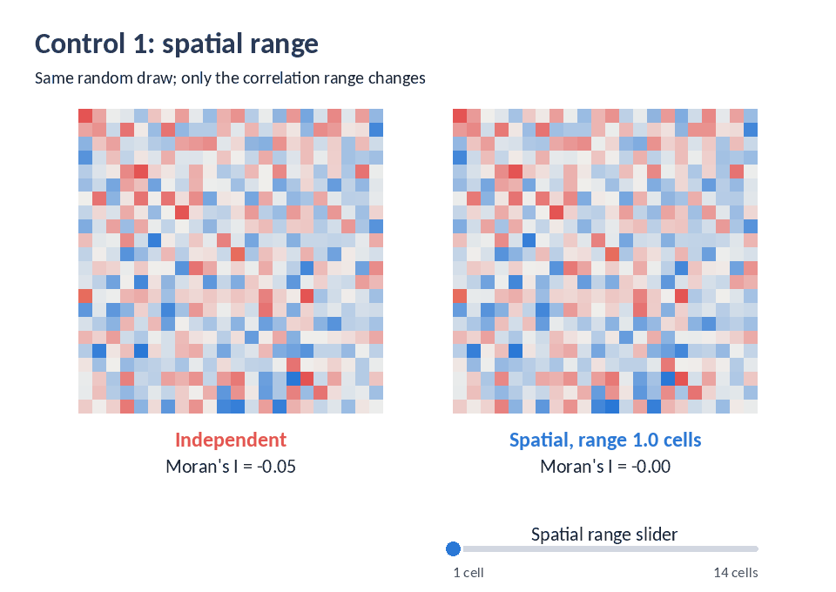
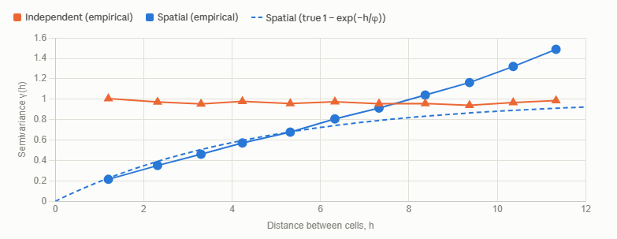
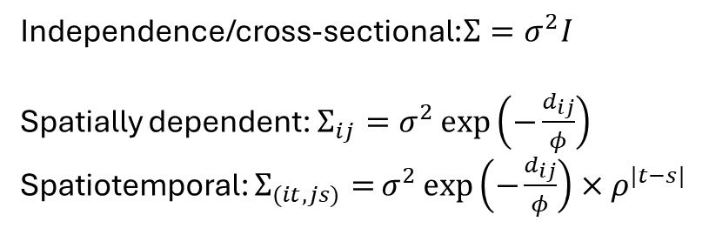
What is spatial statistics?
An illustration of spatial and spatiotemporal dependence
Independence/cross-sectional:$Σ=σ^{2}I$
Spatially dependent: $Σ_{ij}=σ^{2}\exp\left(−\frac{d_{ij}}{φ}\right)$
Spatiotemporal: $Σ_{(it,js)}=$ $σ^{2}\exp\left(−\frac{d_{ij}}{φ}\right)×ρ^{|t−s|}$

Slide 6
Examples of spatial data?
Field | Examples of spatial data | Typical spatial unit
Public health | Vaccination coverage, mortality rates, skilled birth attendance | Individuals, communities, enumeration areas, districts, countries
Macroeconomics | GDP, unemployment, inflation, trade, productivity, economic growth | Countries, regions, states/provinces
Environmental science | Temperature, rainfall, air pollution, soil properties, vegetation, land cover | Monitoring/weather stations, raster cells
Agriculture | Crop yield, soil moisture, nutrient levels, pest prevalence, crop suitability | Fields, GPS points, raster cells
Social sciences | Poverty, deprivation, crime, educational attainment, population density, migration | Households, neighbourhoods, census areas
Ecology | Species locations, abundance, habitat suitability, biodiversity | Observation points, habitats, raster cells

Slide 7
Spatial data types
Data are called spatial if each one of them carries a location (and a time) stamp
There are three broadly different spatial data types
Point-referenced or geostatistical data
Areal or lattice or regional data
Point patterns

Slide 8
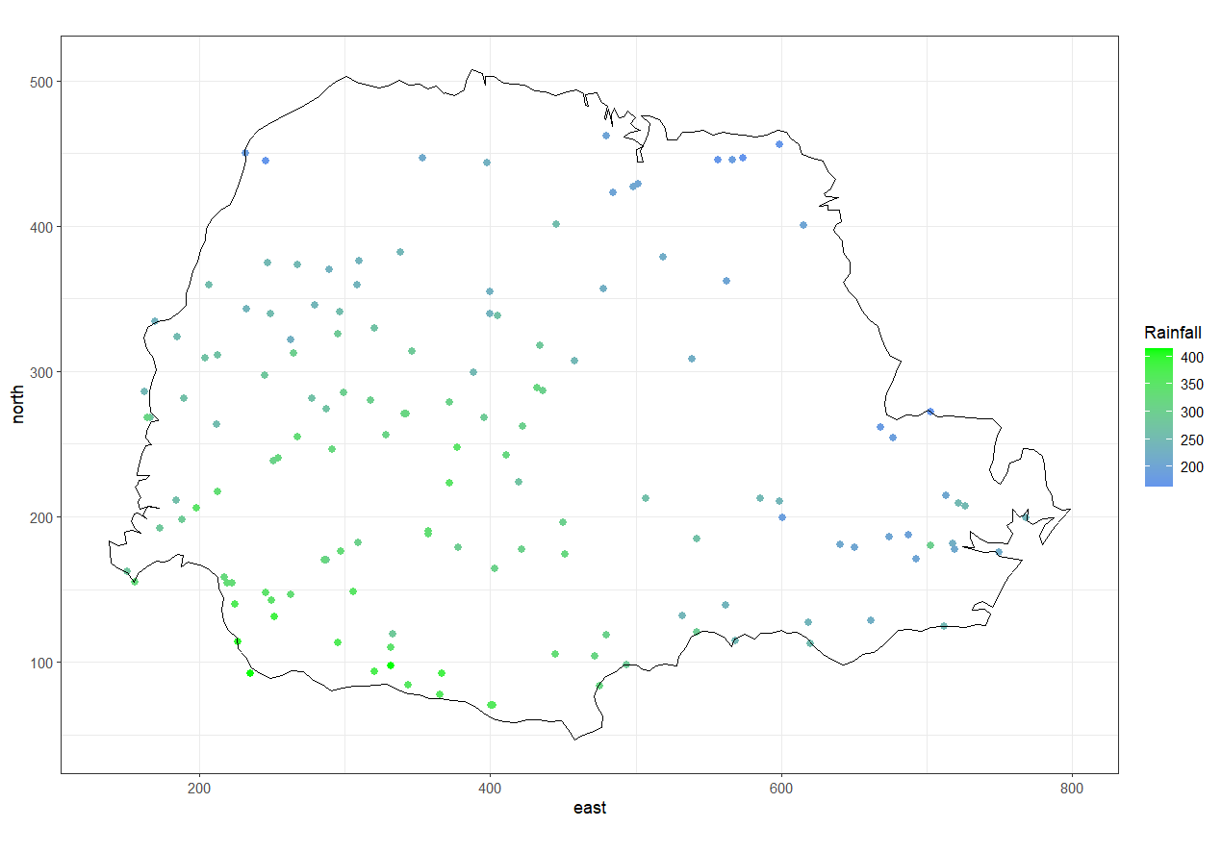
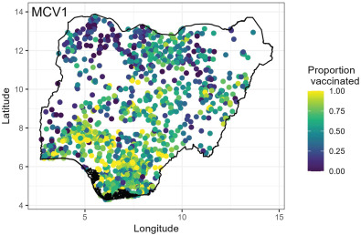
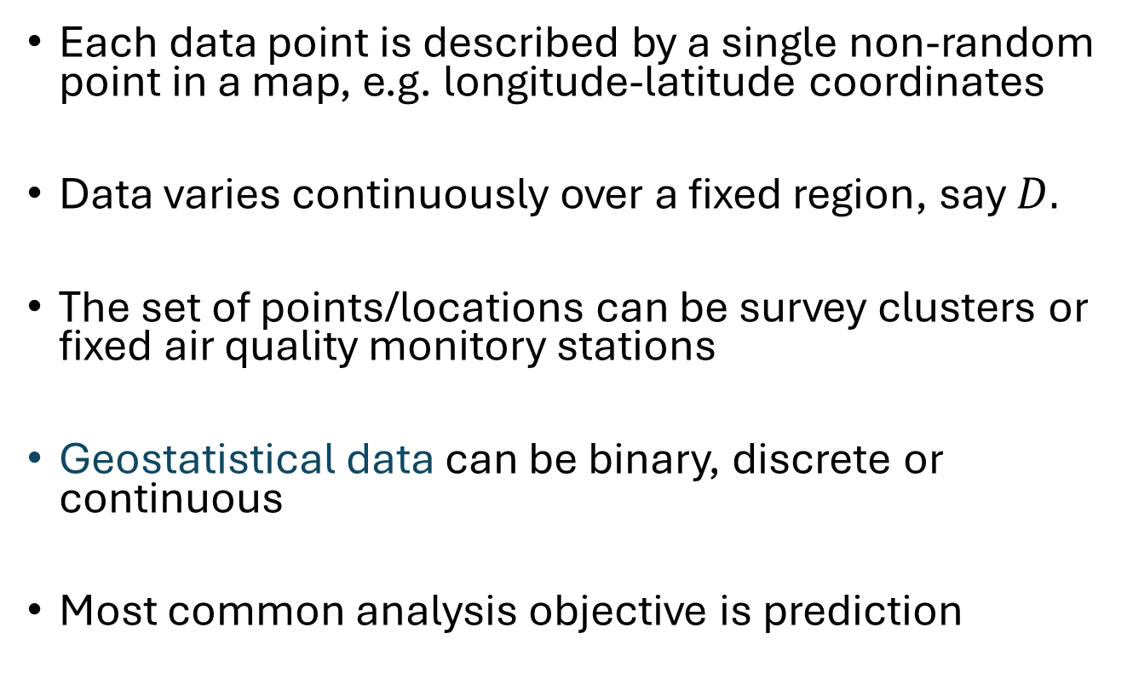
Spatial data types – point-referenced data
Each data point is described by a single non-random point in a map, e.g. longitude-latitude coordinates
Data varies continuously over a fixed region, say $D.$
The set of points/locations can be survey clusters or fixed air quality monitory stations
Geostatistical data can be binary, discrete or continuous
Most common analysis objective is prediction
An attribute of the domain

Slide 9
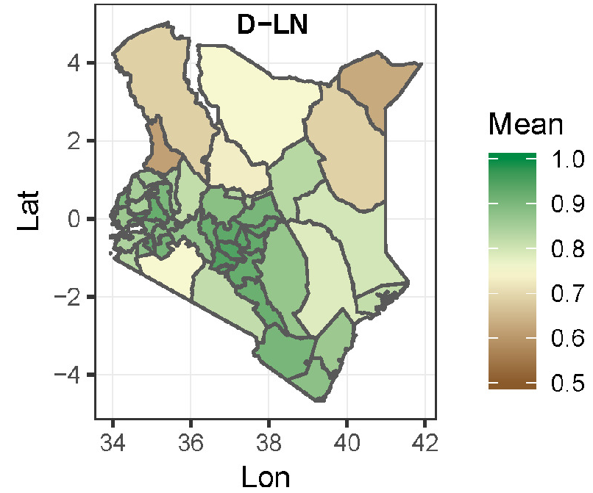
Spatial data types – areal data
Data are observed in fixed, discrete domains, e.g. districts, counties, states or postcodes
Spatial reference for each data is an area/areal region in a map
Examples abound in disease mapping, e.g. covid-19 death rates
Data are often available for all the areas in most applications
Most common analysis objective is to smooth the data to highlight unclear trends
Measles vaccination coverage rates in Kenya

Slide 10
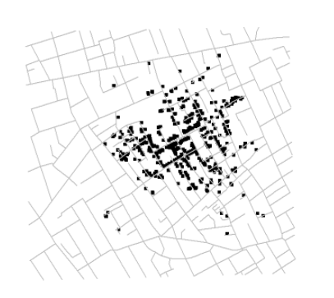
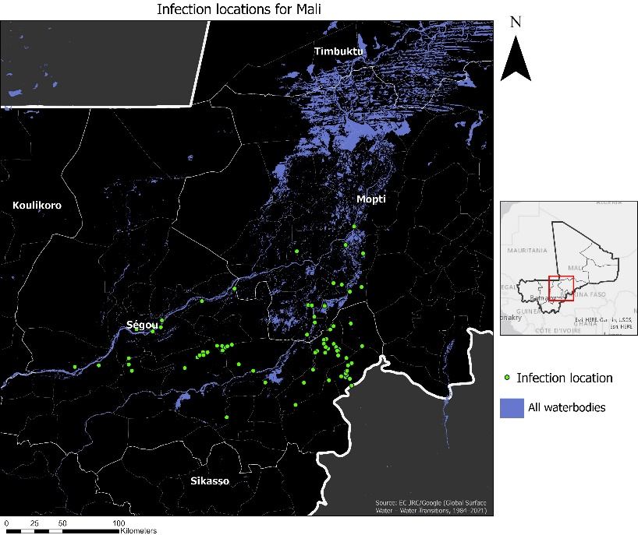
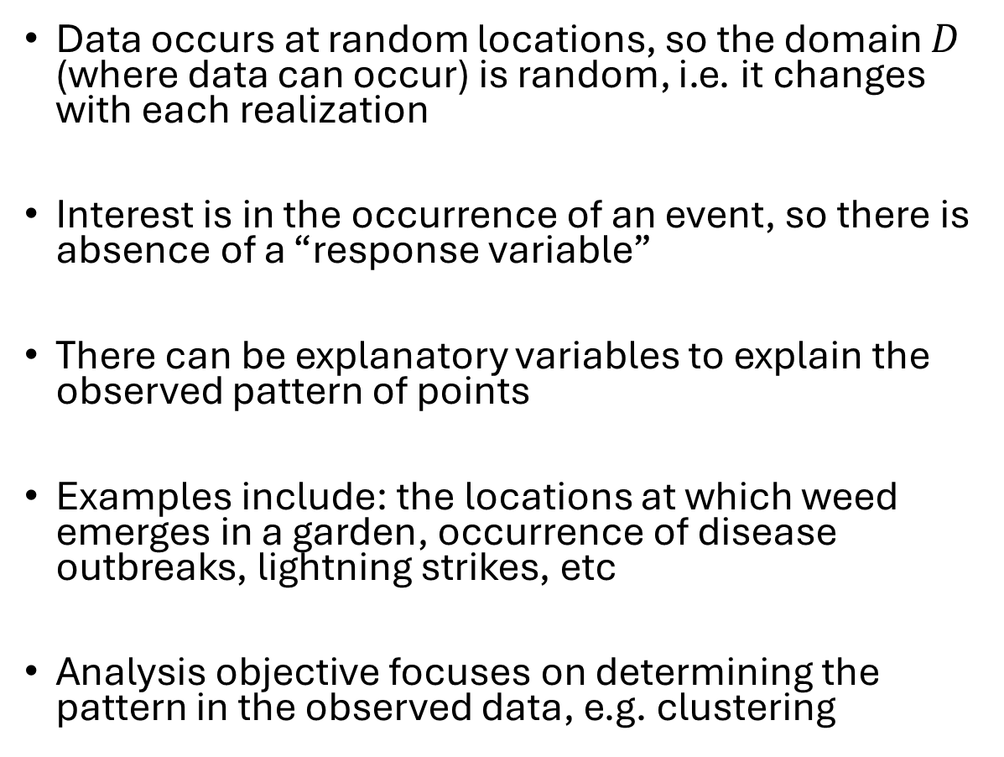
Spatial data types – point patterns
Data occurs at random locations, so the domain $D$ (where data can occur) is random, i.e. it changes with each realization
Interest is in the occurrence of an event, so there is absence of a “response variable”
There can be explanatory variables to explain the observed pattern of points
Examples include: the locations at which weed emerges in a garden, occurrence of disease outbreaks, lightning strikes, etc
Analysis objective focuses on determining the pattern in the observed data, e.g. clustering
Locations of the 1854 London cholera outbreak. Analysis objective could focus on understanding whether outbreaks could be linked to a pump in Broad street.
Detection locations for an infectious disease in Mali

Slide 11
Spatial data types
Note that all three spatial data types are interlinked. For example, we can obtain areal data from a geostatistical process by integrating (sum or average) the outcome within each areal unit.
Also, counting the number of events in the non-overlapping areas of the spatial domain in a point process will produce an areal data.
Point-referenced
Continuous field sampled at fixed points
Block aggregation
Point process modelling or Kernel intensity
Areal (lattice)
Point pattern
Counts per region
Values aggregated over fixed regions
Locations themselves are random

Slide 12
Representing spatial data: coordinate systems
A coordinate system provides a way of assigning numerical values to location on the Earth’s surface (or in a projected map) so that spatial data can be stored, mapped and analysed.
The two main types are:
Geographic coordinate systems
  3D surface, uses angular units (degrees) to represent positions
Projected coordinate systems
  2D surface, uses linear units (meters) to represent locations

Slide 13
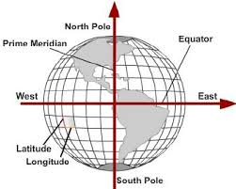
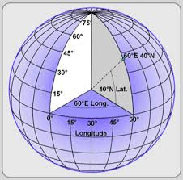
Geographic coordinate systems - latitudes
Latitude coordinates specify north-south position of a point on the Earth’s surface
A latitude measures the angle from the equatorial plane to a given location on the earth’s surface
Latitude angles range from 0◦ (i.e. zero degree) at the Equator to 90◦ (north or south) at the poles
Latitude angles are measured in degrees, minutes and seconds (DMS) or decimal degrees, north or south of the equator
There are 180 degrees of latitude

Slide 14
Geographic coordinate systems - longitudes
Longitudes specify the east-west position of a point on the Earth’s surface
A longitude measures the angle between the prime meridian plane and the north-south plane that intersects a location of interest
The prime meridian is defined as 0◦ Longitude
Longitudes are given east and west of the meridian (180 ◦ in each direction)

Slide 15
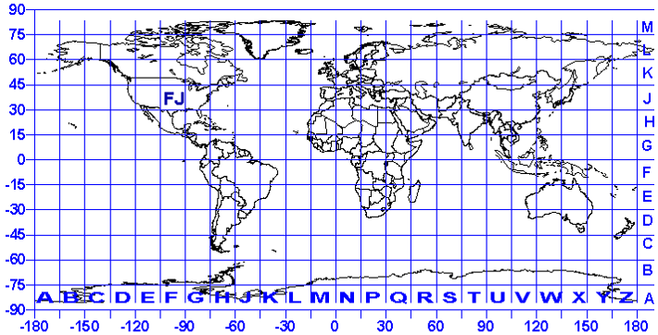
Geographic coordinate systems
2D map showing lines of longitude and latitude
Nigeria lies between latitudes 4° and 14°N, and longitudes 2° and 15°E.

Slide 16
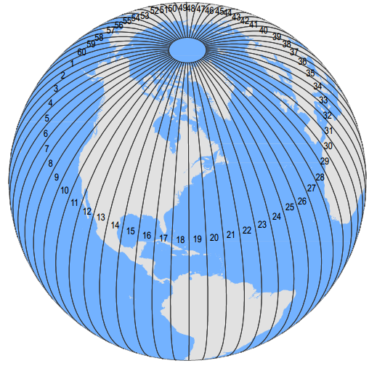
Projected coordinate systems
Map projections are used to transform the Earth’s 3D surface to a 2D plane (can cause distortions)
A common projection is the Universal Transverse Mercator (UTM) which preserves local angles and shapes
A UTM coordinate comprises a zone number, a hemisphere (N/S), an easting and a northing measured in meters
Eastings are referenced from the central meridian of each zone (defined to have a value of 500,000 meters) and northings from the equator (in the north hem. the equator has northing of 0m, in south the northing value of the equator is 10mil. meters)
There are 60 zones, each 6 ◦ longitude in width
Zone 1 starts at 180°W and covers 180°W -174 °W
UTM strips run from 80°S to 84°N

Slide 17
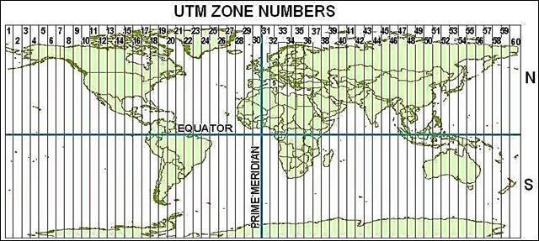
Projected coordinate systems – UTM zones
Nigeria is mostly contained in zone 32N.
Source: https://www.researchgate.net/publication/342330834_An_Introduction_to_Digital_Soil_Mapping/figures?lo=1&utm_source=google&utm_medium=organic

Slide 18
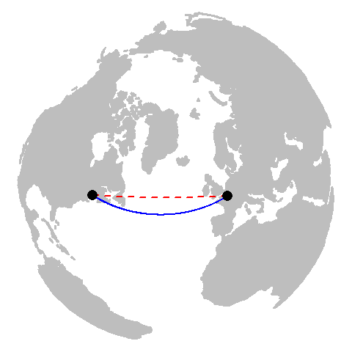
Calculating distances on the Earth’s surface
1) Using geographical coordinates (lon/lat)
  Great circle/spherical/geodetic distance takes into account the curvature of the surface of the Earth. Distance is often given in meters/kilometres.
  The Euclidean distance does not account for this curvature. This is not a major problem if the study area is small, e.g. a country. Distance is given in degree units, needs to be converted to meters/kilometres. 1 degree longitude = 111.32 km at the equator.
NB: Spatial covariance functions use Euclidean distances (this can be corrected by defining our mesh on a sphere if need be). In R, variograms are usually calculated using the great circle distance when using geographical coordinates.

Slide 19
Calculating distances on the Earth’s surface
2) Using projected (UTM) coordinates
  Euclidean distances are normally used here since this projection already takes the curvature into account
  Distances can be calculated in meters/kilometers

Slide 20
Representing spatial data: vector and raster data
There are two fundamental ways of representing spatial information
VECTOR | features
RASTER | grid cells
Points: health facilities or disease cases
Lines: roads or rivers
Polygons: districts or countries
A regular grid in which each cell stores a value—for example, population density, rainfall, temperature, or predicted disease risk.
Objects versus Surfaces

Slide 21
Vector data: points, lines and polygons
POINT
LINE
POLYGON
A specific location
Examples: health facility, survey household, reported disease case
A linear feature
Examples: road, river, travel or transmission network
An enclosed area
Examples: district, country, catchment or ecological zone
Example: In disease mapping, we could map case locations as points, summarize disease counts by district polygons, and use road or river lines to represent potential movement corridors.

Slide 22
Raster data
With raster data, the spatial domain is divided into cells, each storing a value
A raster is a regular grid. Cell values may represent measured, modelled, or classified information.
EXAMPLES
Population density, rainfall, temperature, elevation, prevalence, PM10 concentration, predicted disease risk
RESOLUTION
Cell size controls spatial detail. A 1 km × 1 km raster has cells representing 1 km² areas
NO DATA CELLS
Raster layers often include no data cells indicating unavailable values or locations outside the study region
Illustrative values (e.g., population counts)
12
15
18
21
10
14
17
19
8
11
15
18
Raster is useful when values vary across a surface or predictions are needed on a grid.

Slide 23
Storing spatial data: common spatial data formats
Data formats are chosen based on data structure, use case and software ecosystem
VECTOR FORMATS
RASTER / GRID FORMATS
• Shapefile (.shp): widely supported; several companion files
• GeoPackage (.gpkg): self-contained spatial database
• GeoJSON (.geojson): common in web mapping
• CSV: coordinates can describe points, but spatial metadata may need to be supplied
• GeoTIFF (.tif): common for gridded spatial data
• NetCDF (.nc): climate and multidimensional data
• ASCII Grid: simple text-based raster format
Important note: Before joining or combining spatial data, you need to check the coordinate reference system (CRS), spatial extent, resolution, units, etc and ensure that these are compatible.

Slide 24
In-class exercise
What are suitable representations for these data types (raster, points, lines or polygons)?
  Health facilities or reported cases
  Roads, rivers or movement paths
  Disease prevalence by district
  Population density or rainfall
  Environmental suitability at 1 km resolution
  Predicted continuous disease risk

Slide 25
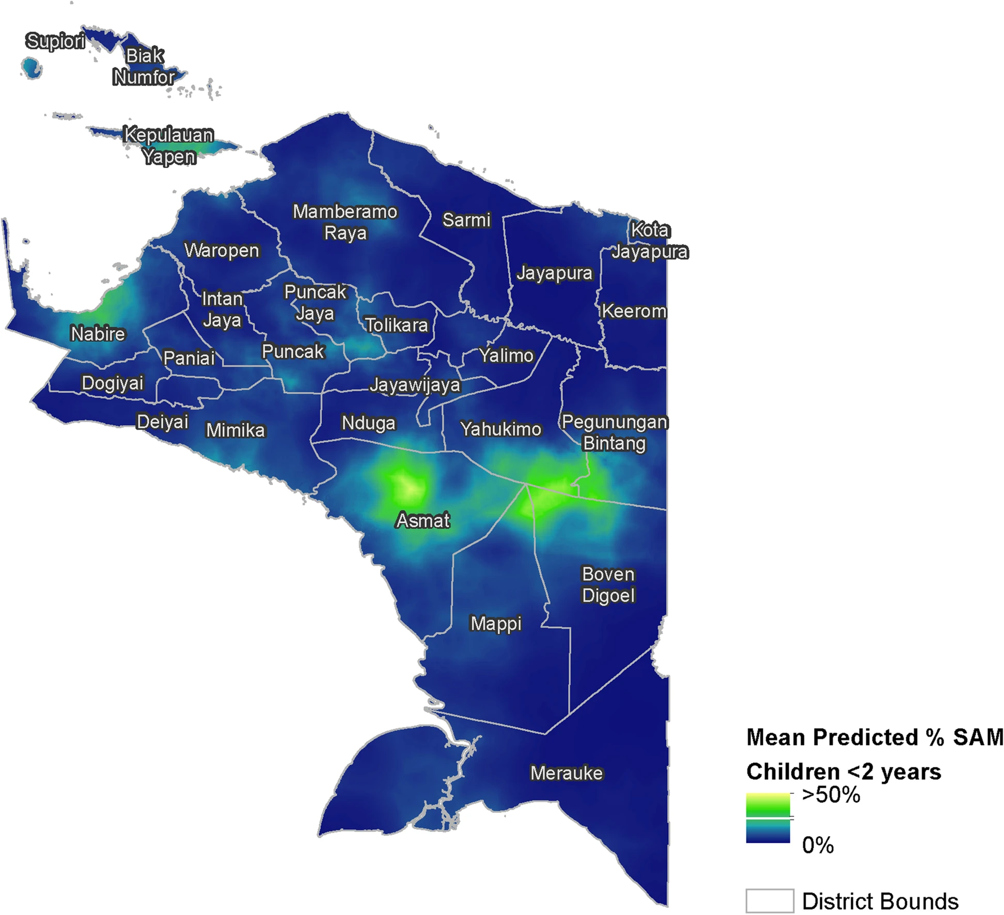
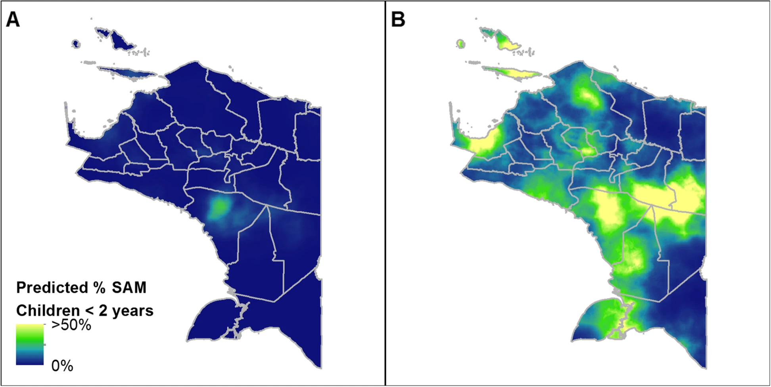
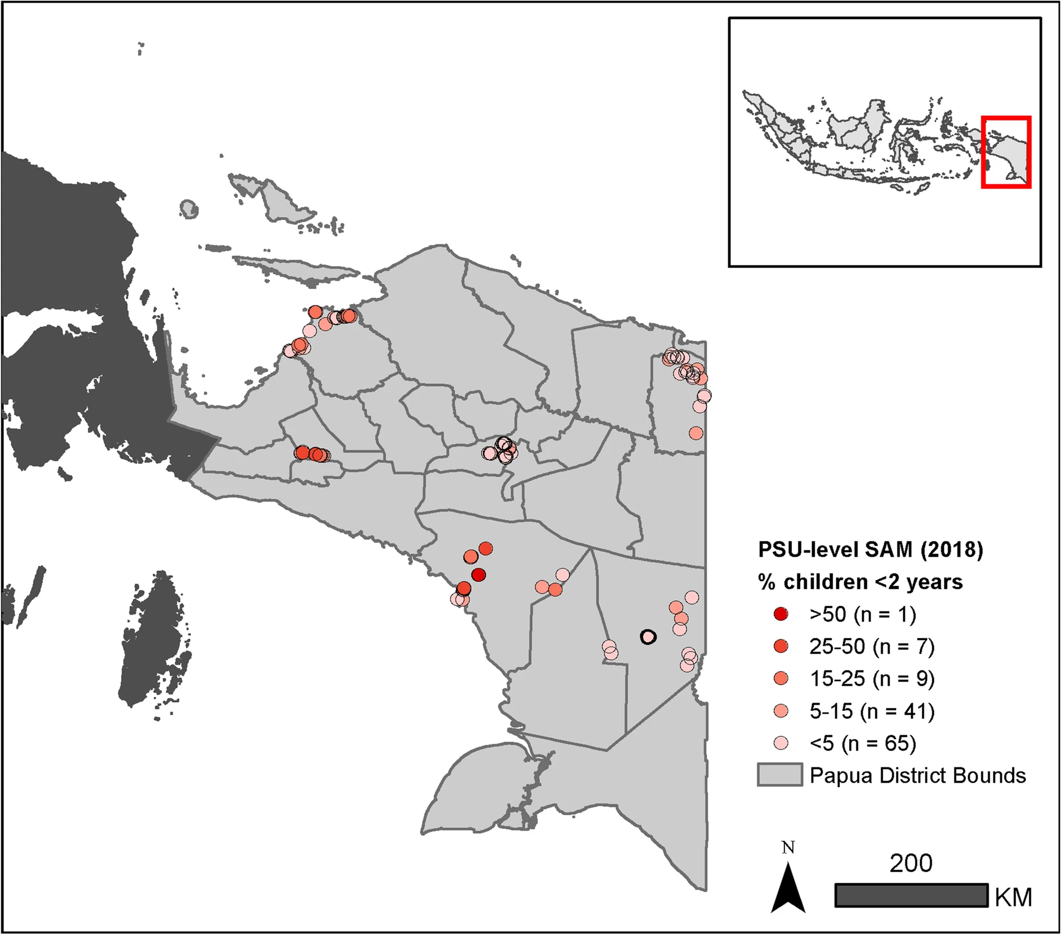
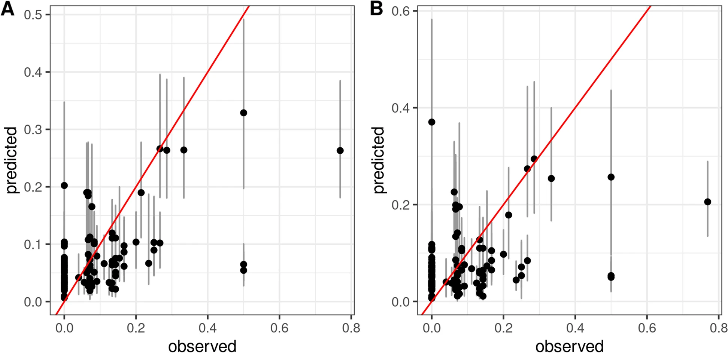
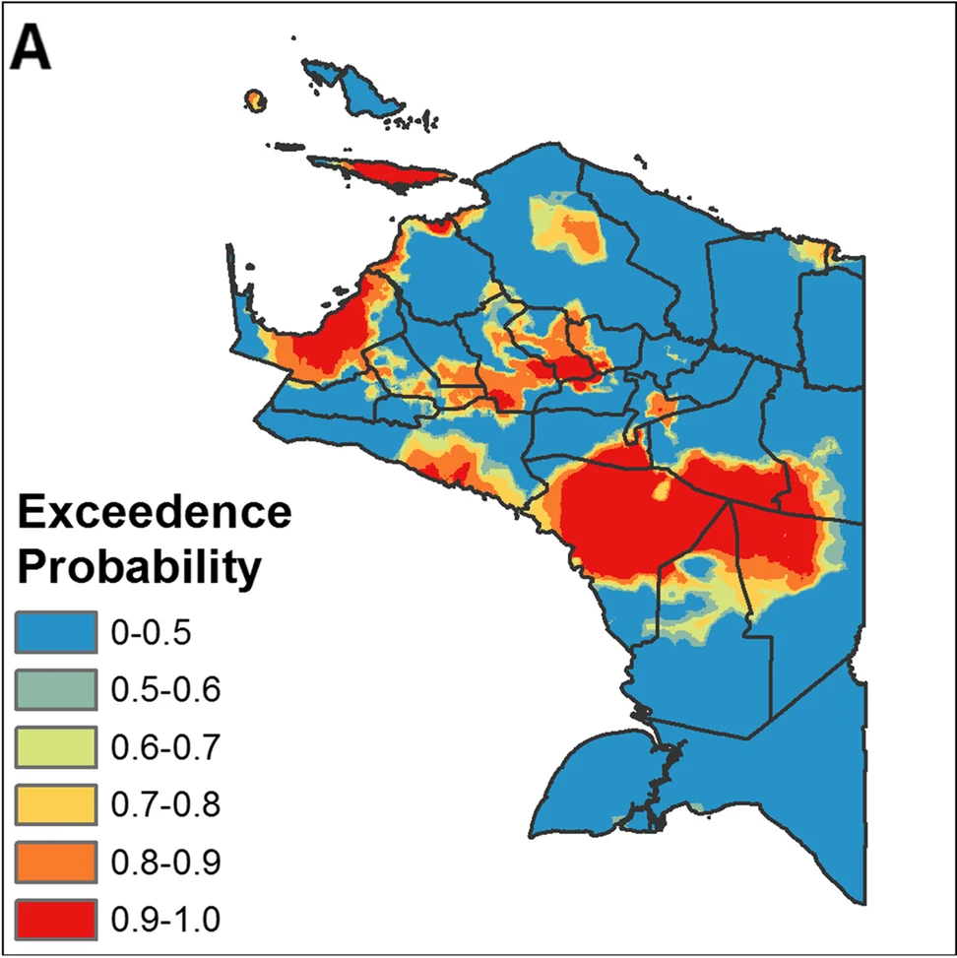
Case study: Mapping malnutrition in Indonesia
https://link.springer.com/article/10.1186/s40795-022-00504-z

Slide 26
Exercise 1: Calculating distances
Run the functions in the R script – “Distance_calc_script.R”
You will need the data files: “Practice_data_outcome.csv” and “Covariates_selected.csv”
The libraries you need are listed at the top of the script

Slide 27
References
Banerjee, S., Gelfand, A. E., & Carlin, B. P. (2025). Hierarchical modeling and analysis for spatial data (3rd ed.). Chapman and Hall/CRC.
Bivand, R. S., Pebesma, E., & Gómez-Rubio, V. (2013). Applied Spatial Data Analysis with R (2nd ed.). Springer.
Sahu, S. K. (2022). Bayesian modelling of spatio-temporal data with R. Chapman and Hall/CRC.
Schabenberger, O., & Gotway, C. A. (2005). Statistical methods for spatial data analysis. Chapman & Hall/CRC.

